Slide 1

Cloud Computing
Simple Chat Server
Hannah Haist ID:752731
Trang Le Hong ID:310195
Felix Schoch ID:761390

Slide 2

Cloud Computing
Component Diagram
Client
Server
Webbrowser
Socket.io
Socket.io
Node.js

Slide 3
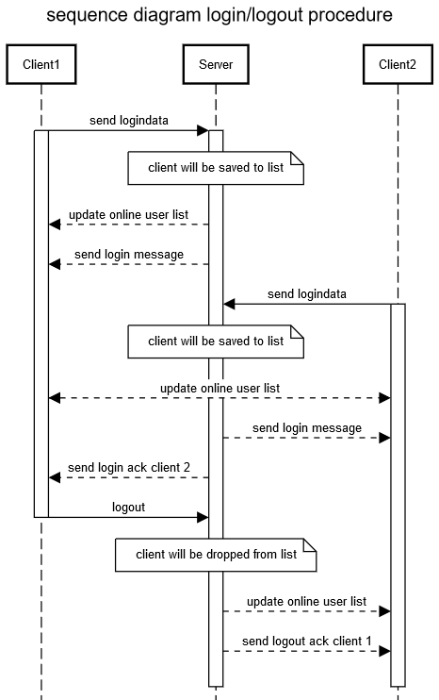
Cloud Computing
Sequence Diagram

Slide 4
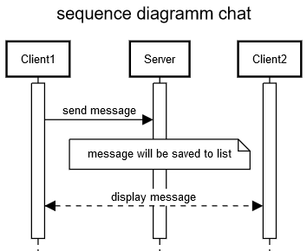
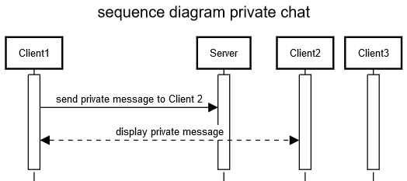
Cloud Computing
Sequence Diagram

Slide 5
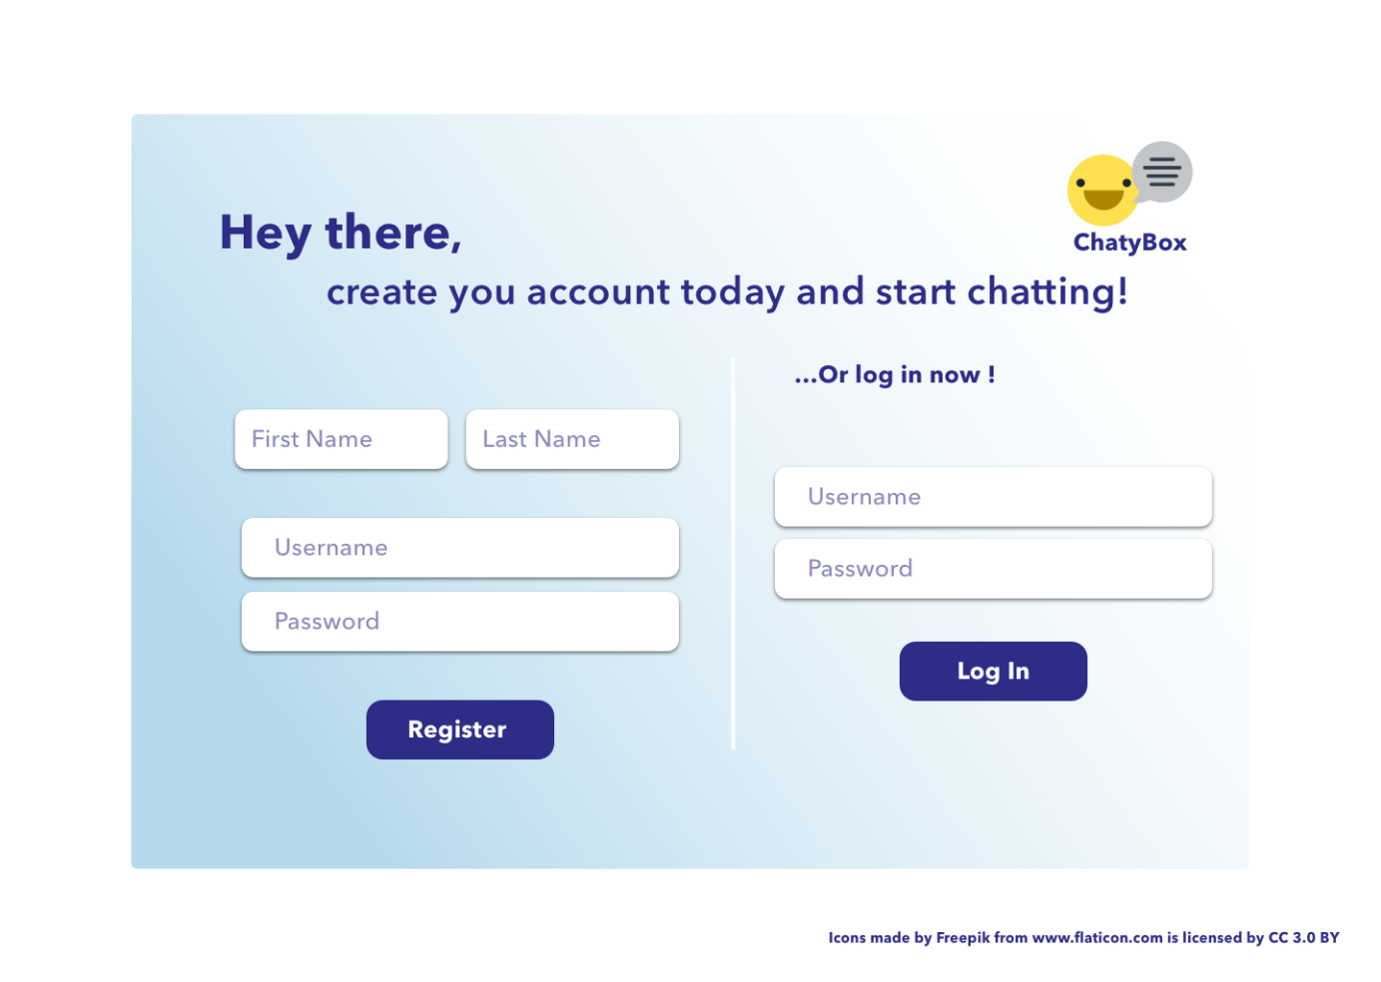
Cloud Computing
Design Mockups

Slide 6
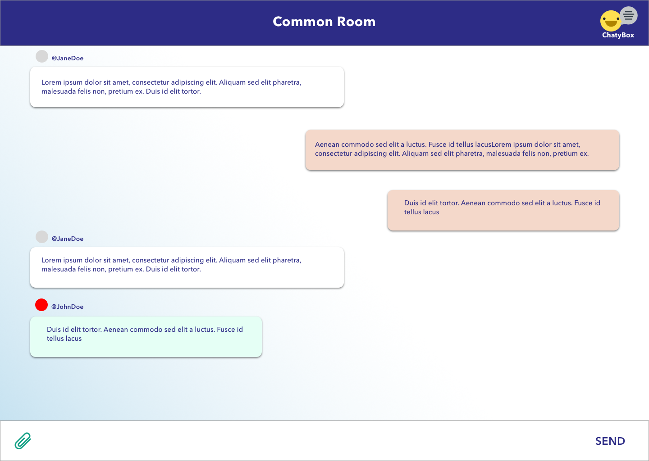
Cloud Computing
Design Mockups

Slide 7
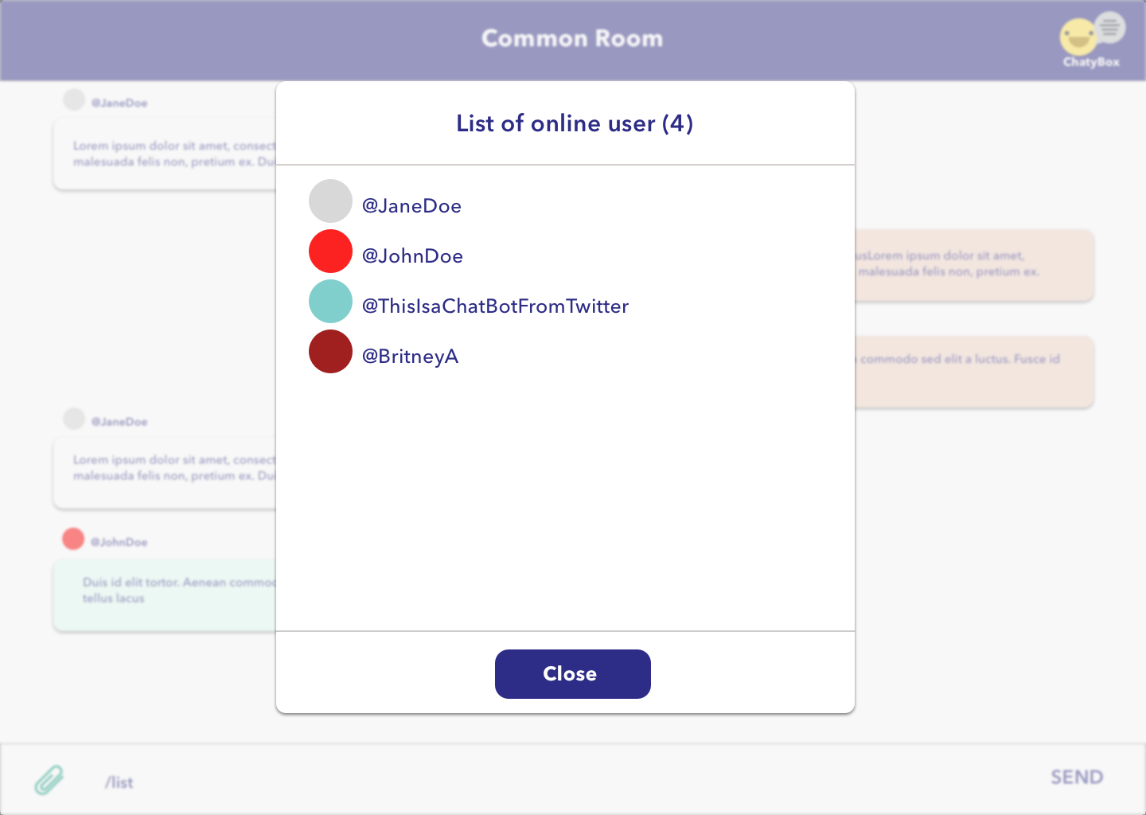
Cloud Computing
Design Mockups

Slide 8

Cloud Computing
Lessons Learned about node.js
easy to set up and host a server with node.js
event-based communication between server and client via methods on() and emit()

Slide 9
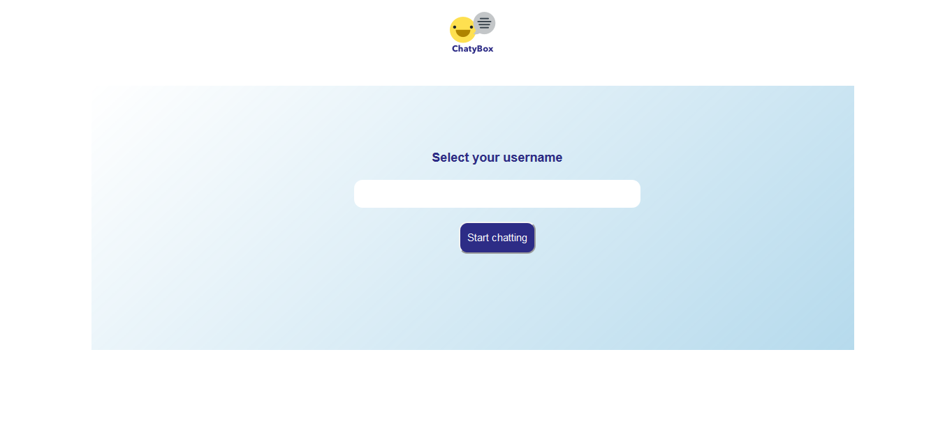
Cloud Computing
Live Presentation

